Slide 1
COnstructive COst MOdel (COCOMO)

Slide 2
COCOMO
Any software development project can be classified into one of the following three categories based on the development complexity— organic, semidetached, and embedded.

Slide 3
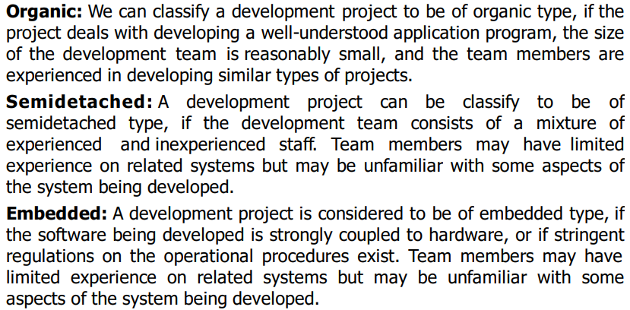
COCOMO

Slide 4
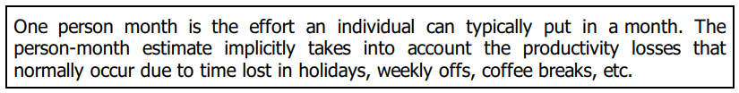
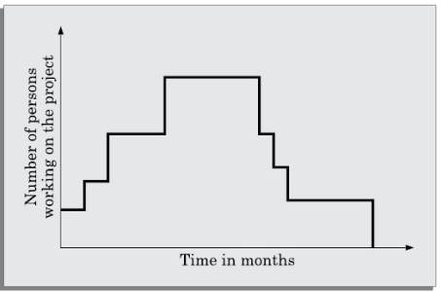
COCOMO

Slide 5
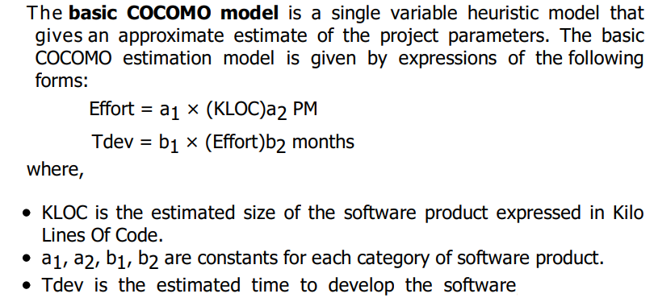
COCOMO

Slide 6
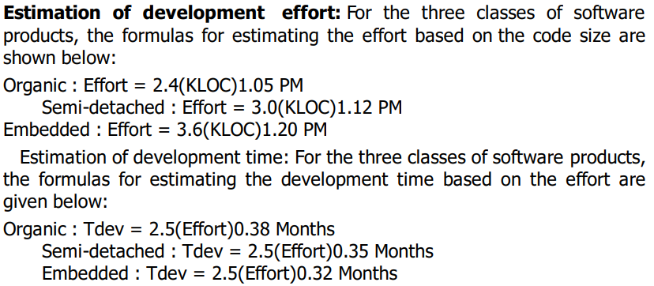
COCOMO

Slide 7
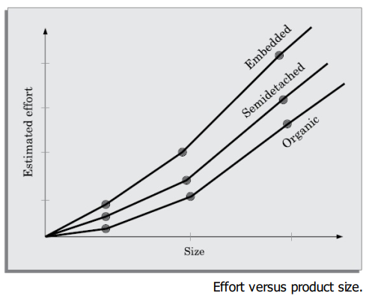
COCOMO

Slide 8
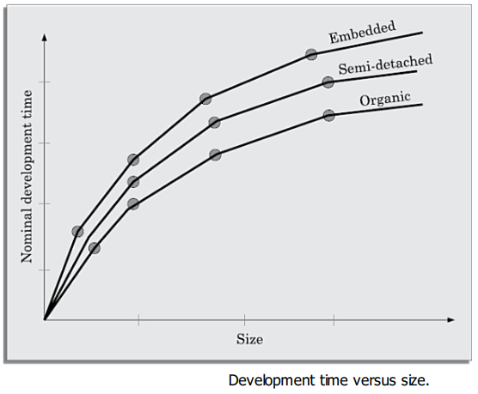
COCOMO

Slide 9
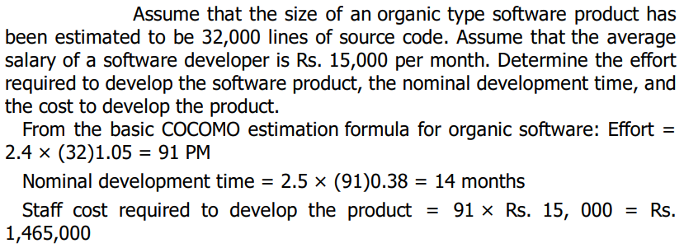
COCOMO

